Slide 1
Chapter 8

Slide 2
Stack
Stack is a one dimensional data structure.
Items are added and removed in last-in first-out manner.
The most recent item is called top of the stack (TOS).

Slide 3
Declaring stack segment
.STACK 100H
When the program is assembled and loaded in memory,
SS register contains the segment number of the stack segment.
SP register is initialized to 100h for the preceding stack declaration. This indicates that the stack is empty. When the stack is not empty, SP contains the offset address of the TOS.

Slide 4
PUSH and PUSHF
PUSH source (e.g. PUSH AX)
source = 16 bit register or memory word
Execution of PUSH causes the following to happen:
SP is decreased by 2.
A copy of the source content is pushed to the address specified by SS:SP. The source is unchanged
PUSHF
This instruction pushes the contents of the FLAGS register onto the stack.
There is no effect of PUSH/PUSHF on the flags.
Illegal: PUSH DL (Byte instruction is illegal)
PUSH 2 (Push of immediate data is illegal)

Slide 5
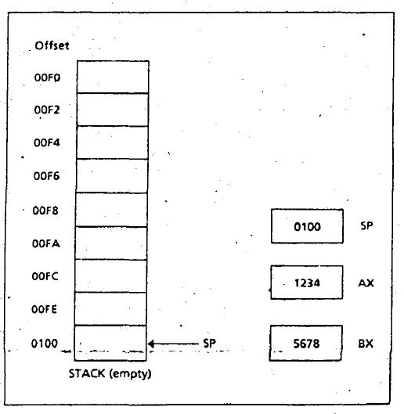
Empty Stack

Slide 6
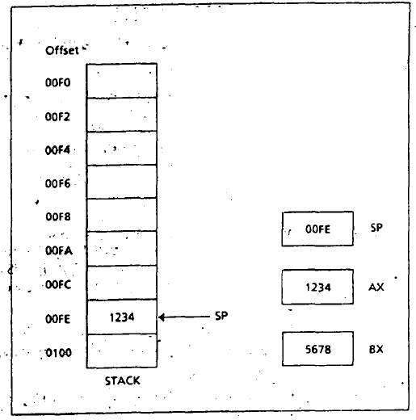
After PUSH AX

Slide 7
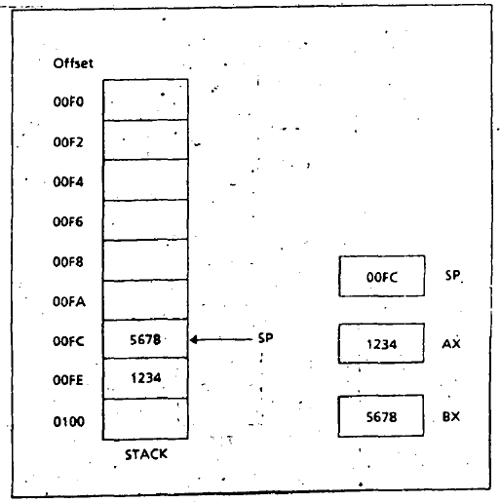
After PUSH BX

Slide 8
POP and POPF
POP destination
destination = 16 bit register (except IP) or memory word
Execution of POP:
The content of SS:SP (TOS) is moved to the destination.
SP is increased by 2.
POPF
This instruction pops the TOS into the FLAGS register.
There is no effect of POP/POPF on the flags.
Illegal: POP DL (Byte instruction is illegal)

Slide 9
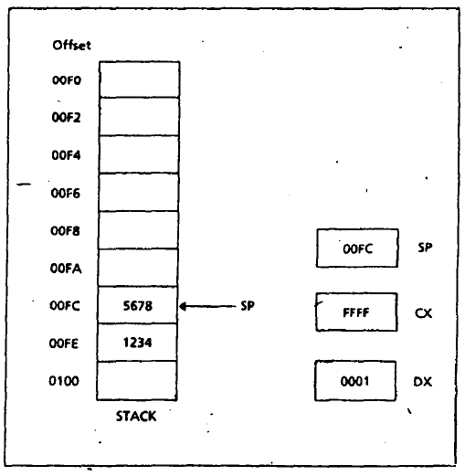
Before POP

Slide 10
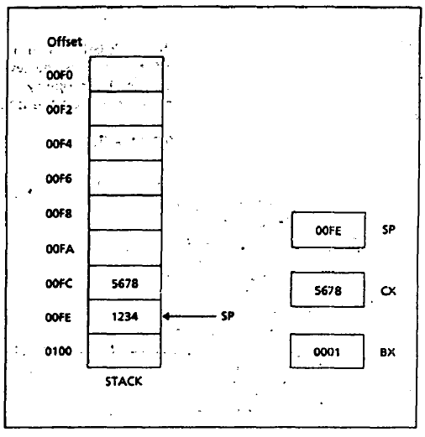
After POP CX

Slide 11
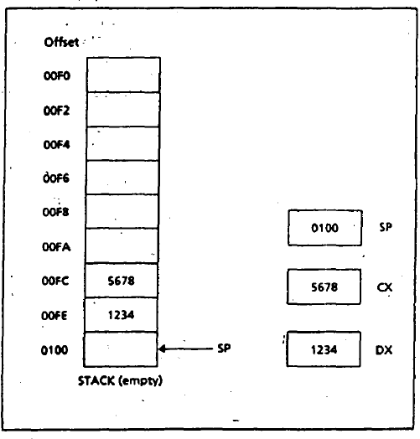
After POP DX

Slide 12
Procedure declaration
name PROC type
;body of the procedure
RET
name ENDP
name = user defined name of the procedure
type = (optional) NEAR or FAR
If type is omitted, NEAR is assumed.
NEAR means caller and called procedures are in the same segment. Far means caller and called procedures are in different segment.

Slide 13
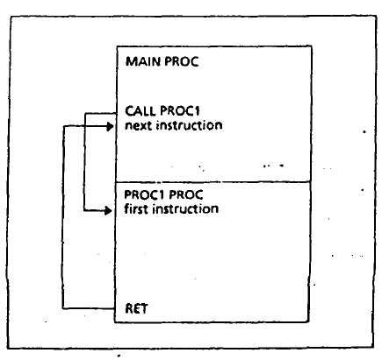
Procedure call and return

Slide 14
CALL
Direct procedure call:
CALL name
name = name of the procedure
Indirect procedure call:
CALL address
address = a register or memory location containing the address of a procedure.

Slide 15
Execution of CALL
Return address of the caller is saved on the stack.
return address = offset of the next instruction after the CALL statement in the caller procedure.
IP gets the offset address of the first instruction of called procedure.
CS:IP = segment:offset of the first instruction of the called procedure.
Control goes to the called procedure.

Slide 16
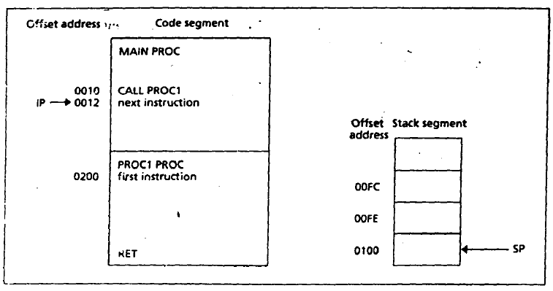
Before CALL

Slide 17
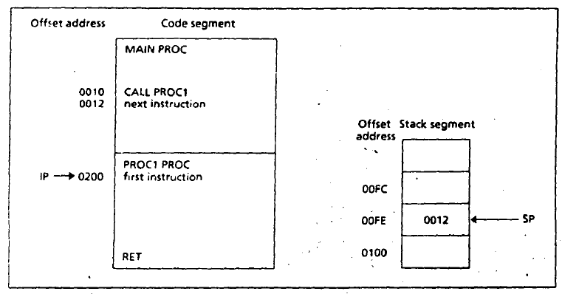
After CALL

Slide 18
RET
RET pop_value
pop_value = (optional)
Execution of RET:
IP gets the value of TOS. So, CS:IP = segment:offset of the return address. Thus, control goes back to the caller program

Slide 19
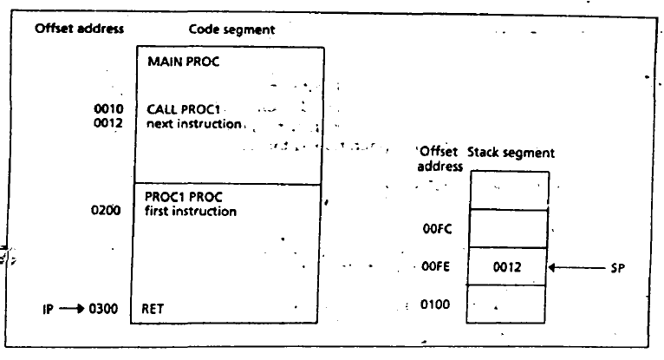
Before RET

Slide 20
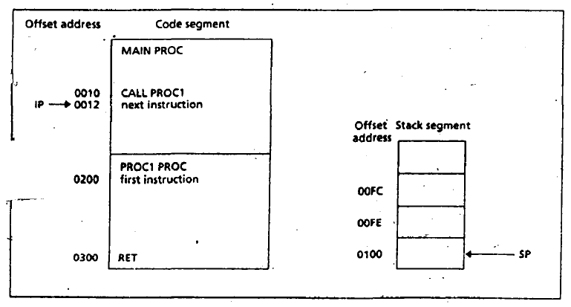
After RET

